Slide 1

BUFFALO
NETWORK
BY BILLS
AKASH PONDURU
KRISHNA SIVAKUMAR

Slide 2
"Tech for Community Connection"
Craft a platform linking students, pros, tech firms, and schools, driving skill growth, mentorship, and networking in Buffalo's tech and start-up landscape

Slide 3
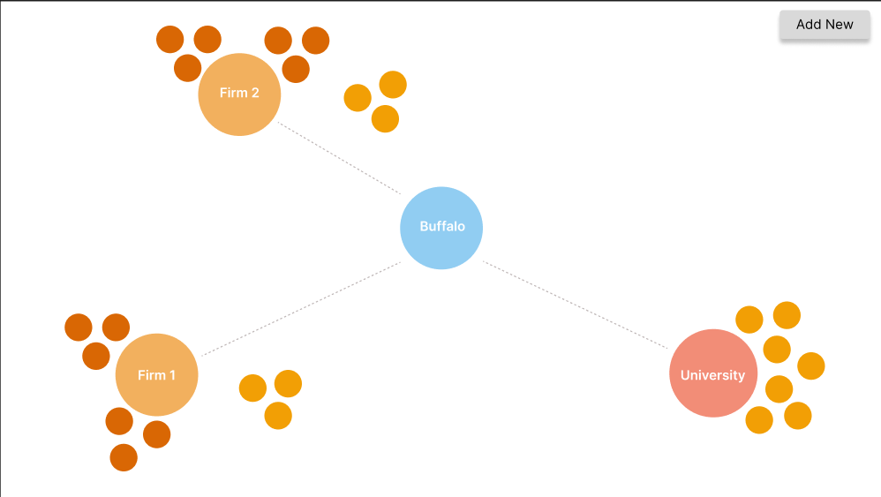
“SOLUTION"
A small web application which simplifies how a community looks like visually and where does a person fit in. Connecting with People should not be complex task, we are trying to make it elementary :)

Slide 4
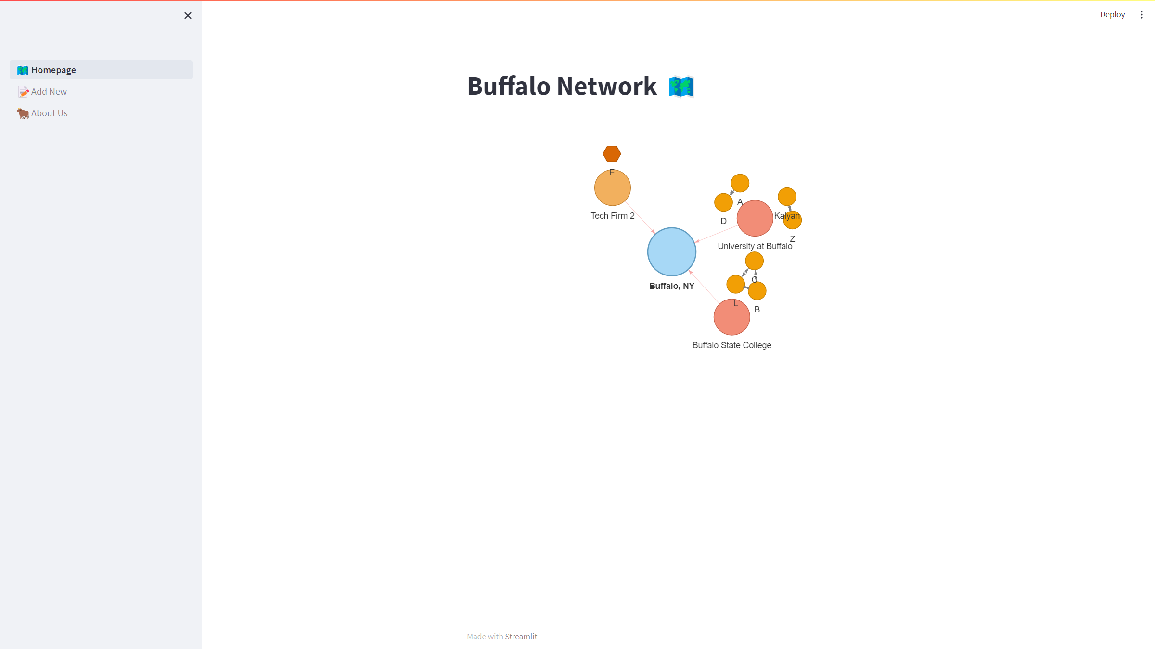
“MVP"
- Simple
- Accessible
- Visual

Slide 5
“MENTORS"
- Maeve Rositzke
Software Engineer, M&T Bank
- Ryan Brown
Principal Engineer, Crunchyroll

Slide 6
“DEMO"
Enjoy :)

